Slide 1
TRIBHUVAN UNIVERSITY • DEPARTMENT OF COMPUTER APPLICATION • FINAL DEFENSE
NTB EVENT MANAGEMENT SYSTEM
A Smart Event Management Platform for Nepal Tourism Board
Presented by: Anjal Joshi • anjaljoshi6@gmail.com
Final Defense • August 2026
✓ All 4 AI Modules Complete ✓ 24 / 24 Automated Tests Passing ✓ Feature-Complete
ASP.NET Core 8
SvelteKit
PostgreSQL 16
AI: TF-IDF · BM25
Department of Computer Application • Tribhuvan University
1 / 23

Slide 2
AGENDA
What We'll Cover Today
01
Introduction & Objectives
05
Live System Walkthrough
Problem, goals, scope and limitations
Public discovery portal + admin control panel
02
System Architecture & Design
06
Testing & Results
Clean Architecture, ERD, use cases, tech stack
24 / 24 automated tests passing
03
AI Modules — All 4 Complete
07
Result Analysis
TF-IDF, BM25, Tag Suggestion, Popularity Scoring
Delivered scope vs. original objectives
04
Guest Invitation & QR Check-in
08
Conclusion & Future Work
New since mid-term — full attendance workflow
Wrap-up and the roadmap ahead
NTB Event Management System • Final Defense • 2026
2 / 23

Slide 3
INTRODUCTION
RESOLVED — FINAL DEFENSE
The Problem We Solved
Nepal's tourism event landscape suffered from fragmentation and a lack of digital structure
No Central Platform
Passive Discovery
Inconsistent Tagging
NTB had no single interface to manage festivals, meetings, holidays and general events.
The public scrolled flat lists — no intelligence behind what was surfaced.
Manual tagging by staff led to mismatched categories and weak filtering.
No Smart Search
No Popularity Signal
Manual Guest Check-in
Plain ILIKE keyword matching returned results with zero relevance ranking.
No way to automatically surface trending or high-impact events.
Inviting and verifying attendees at venues was a paper-based, error-prone process.
NTB Event Management System • Final Defense • 2026
3 / 23

Slide 4
INTRODUCTION
Project Objectives — All Achieved
Every objective set at project inception has been implemented and verified
✓
Design and develop a complete, production-grade event management platform for NTB.
✓
Implement role-based access control — SuperAdmin, Admin, and Client roles.
✓
Build an interactive calendar (month/list view) with dual AD & BS calendar support.
✓
Implement a content-based recommendation engine using TF-IDF and Cosine Similarity.
✓
Develop a smart search module powered by the BM25 probabilistic ranking algorithm.
✓
Create an automated tag suggestion feature using TF-IDF keyword extraction.
✓
Implement a weighted popularity scoring model for intelligent event ranking.
✓
Implement a guest invitation and QR-code based check-in system.
✓
Follow Clean Architecture principles and validate correctness via automated testing.
NTB Event Management System • Final Defense • 2026
4 / 23

Slide 5
INTRODUCTION
Scope & Limitations
In Scope
Limitations / Future Scope
▸ Full event lifecycle: draft, publish, archive
▸ 4 event types — Festival, Meeting, Holiday, General
▸ Image upload & media management
▸ Category / tag management (many-to-many)
▸ RBAC — Super Admin, Admin, Client
▸ JWT auth with refresh-token rotation
▸ Calendar view, filtering & smart search
▸ AI-assisted recommendation, ranking & tagging
▸ Dual AD (English) and BS (Bikram Sambat) dates
▸ Guest invitation via email + QR check-in
○ Content-based recommendations only — collaborative filtering (user behaviour) planned next
○ No ticketing or payment processing yet
○ No native mobile app — responsive web only, by design
○ AI modules compute at request time — background pre-computation & caching planned
NTB Event Management System • Final Defense • 2026
5 / 23

Slide 6
METHODOLOGY
Agile-Incremental Development
Six iterative sprints, each a working vertical slice reviewed against supervisor feedback
1
Core Infrastructure
2
Frontend Foundation
3
Calendar & Public View
DB schema, Clean Architecture, JWT, RBAC, basic CRUD
►
SvelteKit setup, admin panel, forms, image upload
►
Interactive calendar, discovery page, filters
✓ Complete
✓ Complete
✓ Complete
◄ MID-TERM DEFENSE CHECKPOINT
4
AI Modules
5
Guest Invitations & QR
6
Testing & Documentation
TF-IDF/Cosine, BM25, tag suggestion, popularity scoring
►
Invite/guest model, QR generation, email, scan/verify
►
24-case automated suite, result analysis, final report
✓ Complete
✓ Complete
✓ Complete
NTB Event Management System • Final Defense • 2026
6 / 23

Slide 7
BACKGROUND
Literature Review
Comparing this platform's approach against existing systems and published research
Eventbrite
Nepal Tourism Portals
This System
Global event platform — recommendations rely on collaborative filtering from purchase history and user behaviour. Requires large behavioural datasets, unsuitable for a new platform with a cold start.
Existing government portals (e.g. tourismdepartment.gov.np) serve static content only — no dynamic events, admin workflows, or intelligent discovery.
Content-based TF-IDF + Cosine Similarity works well from day one with no user history required — ideal for NTB's cold-start scenario.
Supporting Research
▸ Robertson & Zaragoza (2009) establish BM25 as a robust, parameter-tunable text-retrieval algorithm — the same ranking core used by Elasticsearch and Lucene.
▸ Lops et al. (2011) identify TF-IDF as a foundational, highly interpretable method for content-based filtering in text-rich domains — directly applicable to events.
NTB Event Management System • Final Defense • 2026
7 / 23

Slide 8
ARCHITECTURE
System Architecture
Clean Architecture backend + a SvelteKit backend-for-frontend (BFF)
API Layer
Frontend — SvelteKit + TypeScript + BFF
Controllers · JWT Auth · Swagger · CORS
Reactive SPA/SSR UI · admin dashboard · public portal
Server routes proxy the API — access tokens never reach the browser
▼
Application Layer
Services · Repository Contracts · DTOs · TF-IDF / BM25 / Popularity / Tag logic
Database — PostgreSQL 16
▼
EF Core for CRUD · Dapper for performance-critical list queries
JSON columns for images / highlights
Infrastructure Layer
EF Core · Dapper · PostgreSQL · BCrypt · QRCoder · SMTP
▼
Domain Layer
AI Modules — Pure C# (No 3rd-Party AI)
Entities (Event, User, Category, Tag, Guest, Invitation) & Enums
TF-IDF · Cosine Similarity · BM25
Keyword Extraction · Levenshtein · Weighted Scoring
NTB Event Management System • Final Defense • 2026
8 / 23

Slide 9
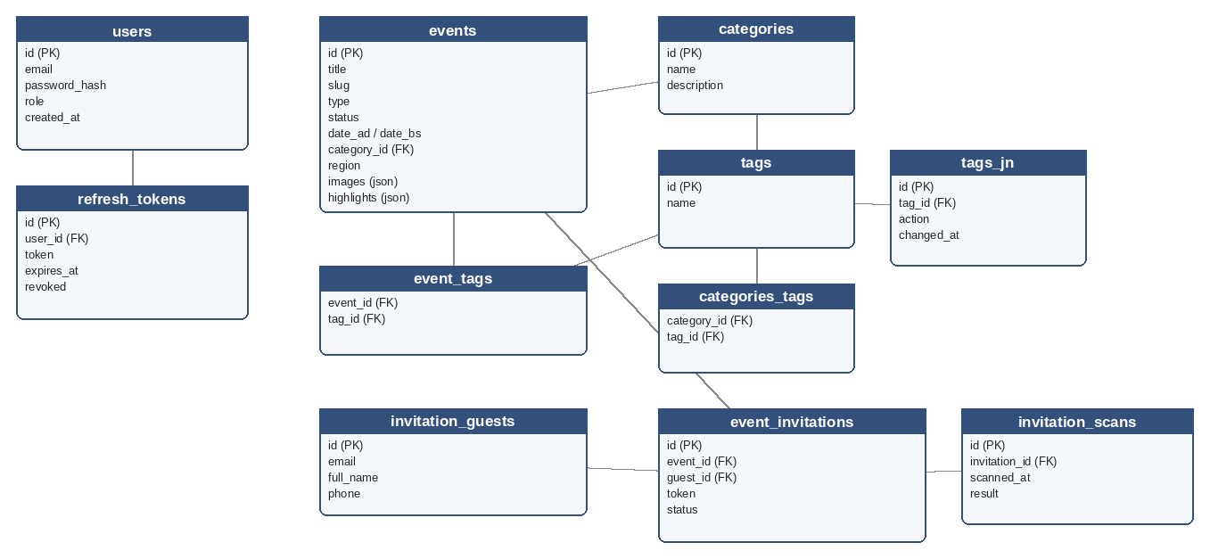
DESIGN
Database Design — Entity Relationship Diagram
PostgreSQL schema covering events, users, tags, and the guest invitation / QR workflow
events · users · refresh_tokens · categories · tags · event_tags · categories_tags · invitation_guests · event_invitations · invitation_scans
NTB Event Management System • Final Defense • 2026
9 / 23

Slide 10
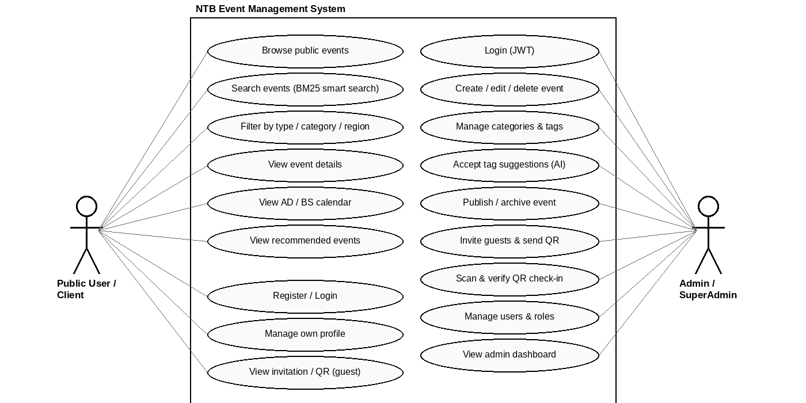
DESIGN
Use Case Diagram
Two actor groups — Public Users / Clients and Administrators — interact with the platform
NTB Event Management System • Final Defense • 2026
10 / 23

Slide 11
ARCHITECTURE
Technology Stack
Backend
Data Access
Security
• ASP.NET Core 8
• PostgreSQL 16
• JWT + Refresh Tokens
• Clean Architecture
• EF Core 8
• BCrypt.Net hashing
• Dapper
AI & Algorithms
Frontend
Tooling
• TF-IDF · BM25
• SvelteKit + TypeScript
• QRCoder · SMTP
• Cosine Similarity
• Tailwind / CSS Vars
• Swagger/OpenAPI
• Levenshtein
• xUnit + Moq · Git
NTB Event Management System • Final Defense • 2026
11 / 23

Slide 12
AI MODULES
Not SQL queries. Not 3rd-party AI. Pure algorithms.
4 Self-Built AI Modules
All implemented natively in C# — no external AI API dependency
01 Recommendation Engine
02 Smart Search
Algorithm: TF-IDF + Cosine Similarity
Algorithm: BM25 (Okapi Best Match 25)
Suggests similar events by content — title (3×), summary (2×), description, category, region & tags.
Probabilistic ranking — the same algorithm behind Elasticsearch, Solr and Lucene.
GET /api/events/{id}/recommendations
GET /api/events/search
03 Auto Tag Suggestion
04 Popularity Scoring
Algorithm: TF-IDF Keyword Extraction + Levenshtein
Algorithm: Weighted Multi-Factor Scoring
Extracts keywords from title/description and fuzzy-matches them to existing tags.
Ranks events by rating, engagement, featured status & recency with exponential decay.
POST /api/events/suggest-tags
EventDto.PopularityScore
NTB Event Management System • Final Defense • 2026
12 / 23

Slide 13
AI DEEP DIVE
Recommendation Engine
TF-IDF vectorization → Cosine Similarity → Top-5 similar published events
1
Build Corpus
2
Tokenize & IDF
3
TF-IDF Vectors
4
Cosine Similarity
Concatenate title (3×), summary (2×), description, category, region & tags per event.
►
Remove stop-words; compute IDF = log((1+N)/(1+df(t)))+1 across the corpus.
►
TF(t,d) × IDF(t) gives each event a sparse, high-dimensional vector.
►
sim(A,B) = (A·B) / (‖A‖×‖B‖) → score 0–1. Sort descending, return top-5.
TF-IDF(t,d) = TF(t,d) × IDF(t) similarity(A,B) = (A · B) / (‖A‖ × ‖B‖)
Why this is NOT a SQL query
▸ All computation runs in the C# application layer, in memory — the database only supplies raw event data.
▸ SQL cannot compute vector dot products or cosine distance natively.
▸ Verified end-to-end by the system test Recommendations_ForFestivalEvent_ReturnsSimilarCategoryEventsOnly.
NTB Event Management System • Final Defense • 2026
13 / 23

Slide 14
AI DEEP DIVE
Smart Search — BM25 Ranking
Probabilistic relevance ranking — the same algorithm used by Elasticsearch and Lucene internally
Score(D,Q) = Σ IDF(qi) × [ f(qi,D) × (k1+1) ] / [ f(qi,D) + k1 × (1 − b + b × |D| / avgdl) ]
f(qi,D) = term frequency in D · |D| = document length · avgdl = average doc length · k1 = 1.5 · b = 0.75
Why BM25 over ILIKE
How it runs
▸ Plain ILIKE returns everything containing the term — with zero relevance ranking.
▸ BM25 rewards frequent, discriminative terms without unfairly favouring longer documents.
▸ The admin panel's existing ILIKE filter is untouched; BM25 is an additive public search path.
▸ Searchable text = title + summary + location + region, tokenized into an in-memory inverted index (Bm25Ranker).
▸ Each query scores in O(k) time, where k is the number of matching terms.
▸ Endpoint: GET /api/events/search — driven by the search box in PublicNav.svelte.
Verified by system test SmartSearch_DashainFestivalQuery_RanksFestivalEventsHigher — festival events rank above unrelated events for a festival query.
NTB Event Management System • Final Defense • 2026
14 / 23

Slide 15
AI DEEP DIVE
Tag Suggestion & Popularity Scoring
Two more algorithms that make the platform smarter without any ML infrastructure
Automated Tag Suggestion
Weighted Popularity Scoring
TF-IDF Keyword Extraction + Levenshtein Fuzzy Match
Multi-Factor Score + Exponential Recency Decay
▸ Tokenize title + description, remove stop-words.
▸ Score tokens via TF-IDF against the published-event corpus.
▸ Select top-K tokens as candidate keywords.
▸ Fuzzy-match candidates to existing tags using Levenshtein edit distance.
▸ Return ranked tag suggestions to the admin's “Suggest tags” button.
Score = W_r·Rating + W_a·Attendance + W_f·Featured + W_d·Recency
W_r=0.35
Rating — strongest quality signal
W_a=0.25
Attendance / engagement proxy
W_f=0.20
Featured boost (admin-marked)
W_d=0.20
Recency — e^(−0.01 × days)
Verified fuzzy-match case:
Powers the homepage's featured-events ordering — computed entirely in C#, no DB aggregation query.
Typo “festivle” → correctly resolves to → “Festival”
NTB Event Management System • Final Defense • 2026
15 / 23

Slide 16
NEW SINCE MID-TERM
EXTENDS ORIGINAL SCOPE
Guest Invitation & QR Check-in
A full digital attendance workflow spanning Domain, Application, Infrastructure and API layers
1
2
3
4
5
Admin Invites Guest
►
QR + Email Sent
►
Guest Presents QR
►
Admin Scans
►
Verify & Check-in
Enter guest email — generates a unique invite token
QRCoder generates a QR; SMTP delivers the invite link
Guest opens their landing page and shows the QR at the venue
Door-side scan looks up the invitation for a preview (no consume)
Admin confirms — QR is consumed / expired, cannot be reused
Invitation Status Lifecycle
pending
→
sent
→
verified
→
expired
→
cancelled
Guest, Invitation and InvitationScan entities (Domain) · InvitationService (Application) · GuestRepository, InvitationRepository, QrCodeService, SmtpEmailService (Infrastructure) · InvitationsController (API)
NTB Event Management System • Final Defense • 2026
16 / 23

Slide 17
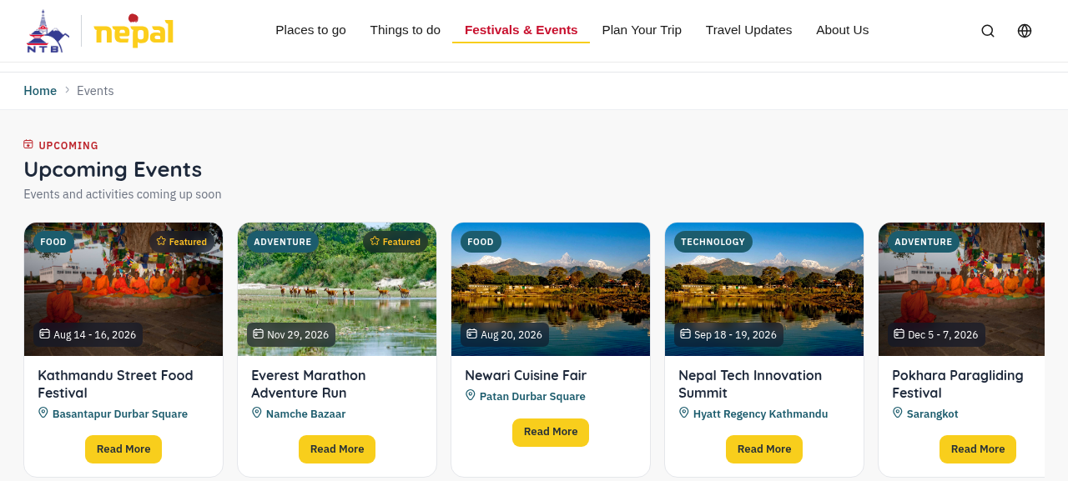
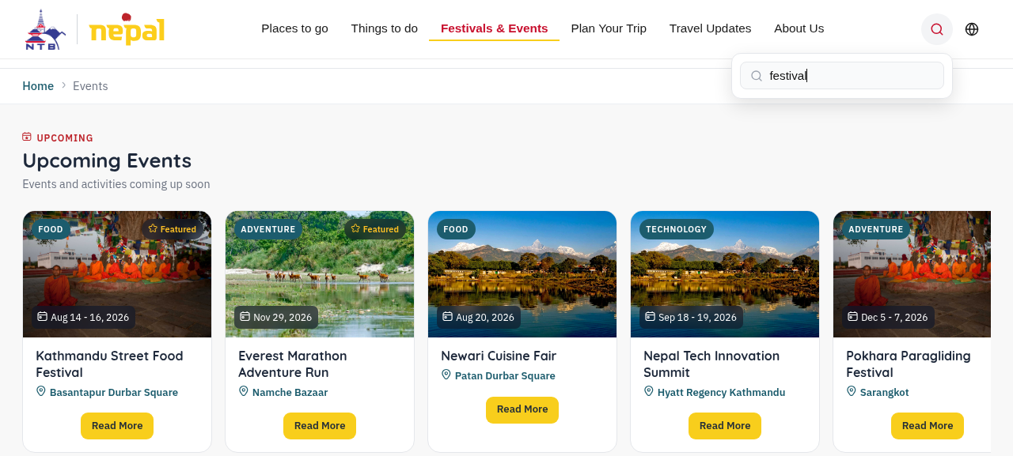
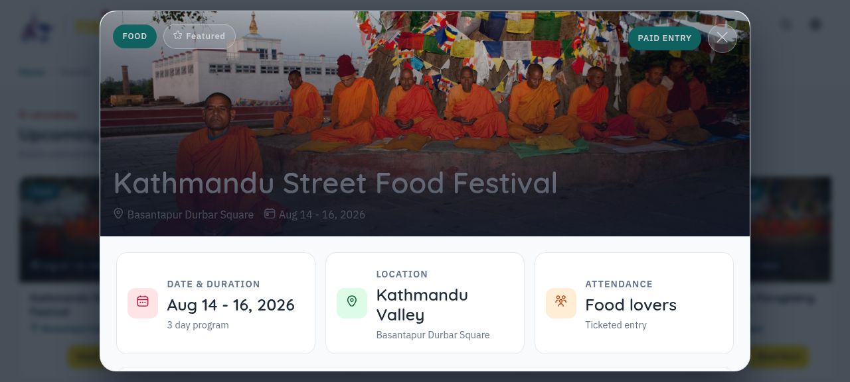
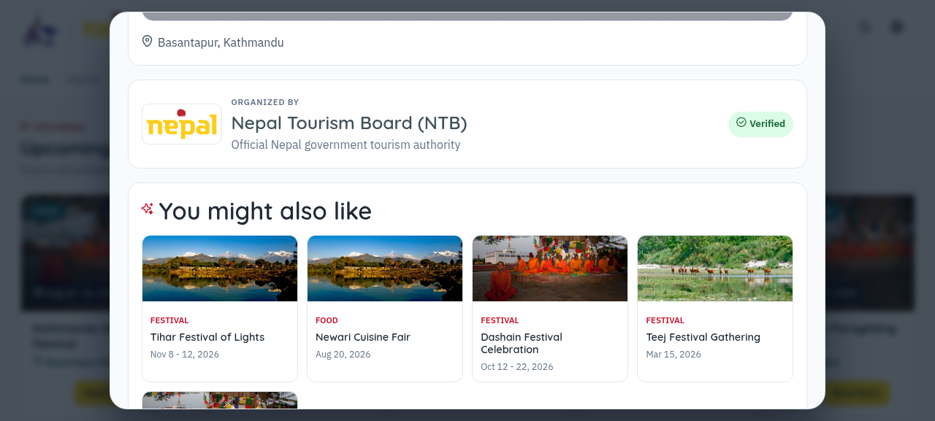
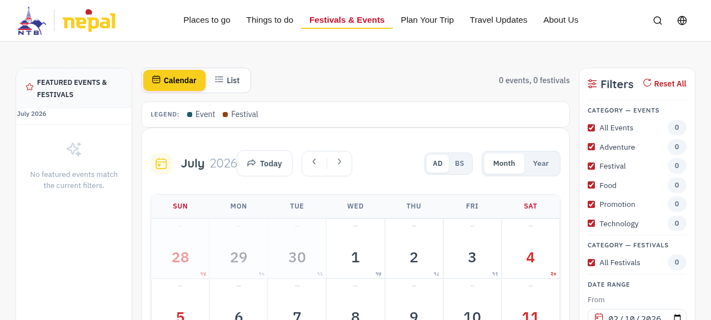
LIVE SYSTEM
Public Portal — Working Screenshots
Homepage — Featured Events
Smart Search Results (BM25-ranked)
Event Details Modal
Public Portal Highlights
▸ Browse, filter & search events
▸ AI recommendations per event
▸ Dual AD / BS calendar toggle
▸ Region, category & type filters
“You Might Also Like” — AI Recommendations
Interactive Calendar (AD / BS Toggle)
NTB Event Management System • Final Defense • 2026
17 / 23

Slide 18
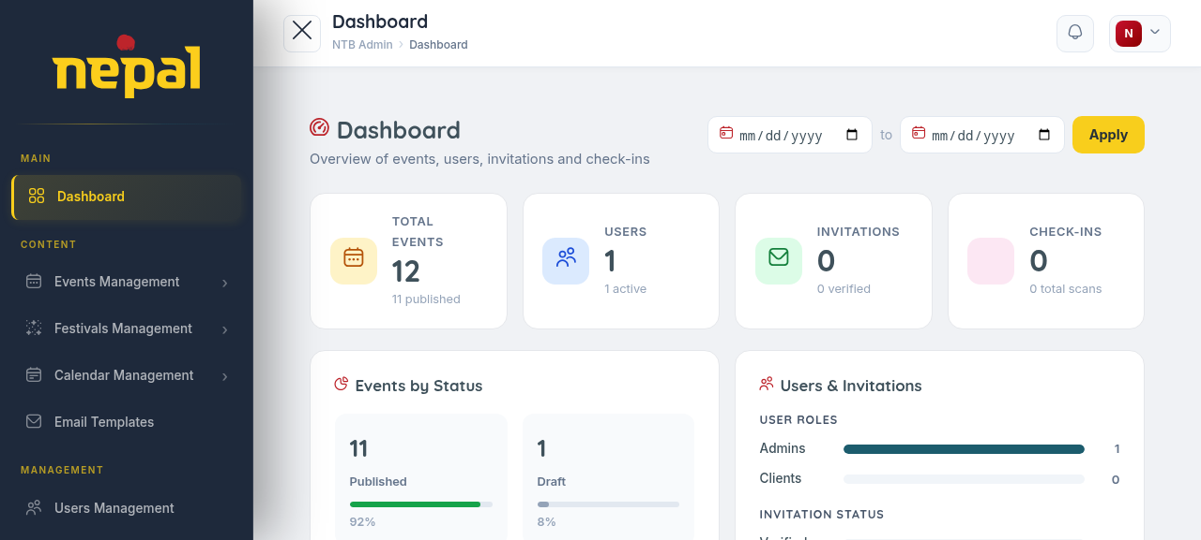
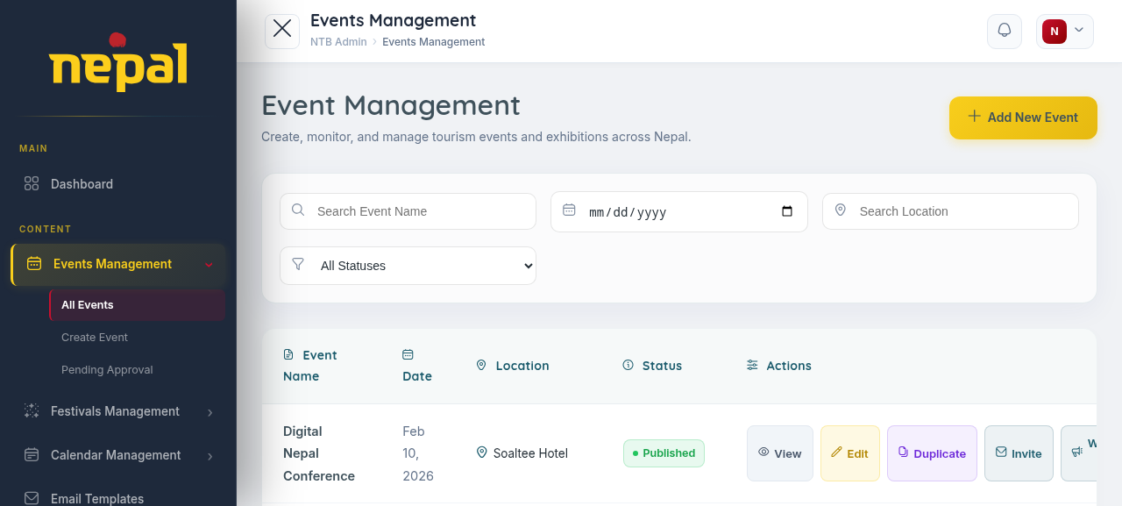
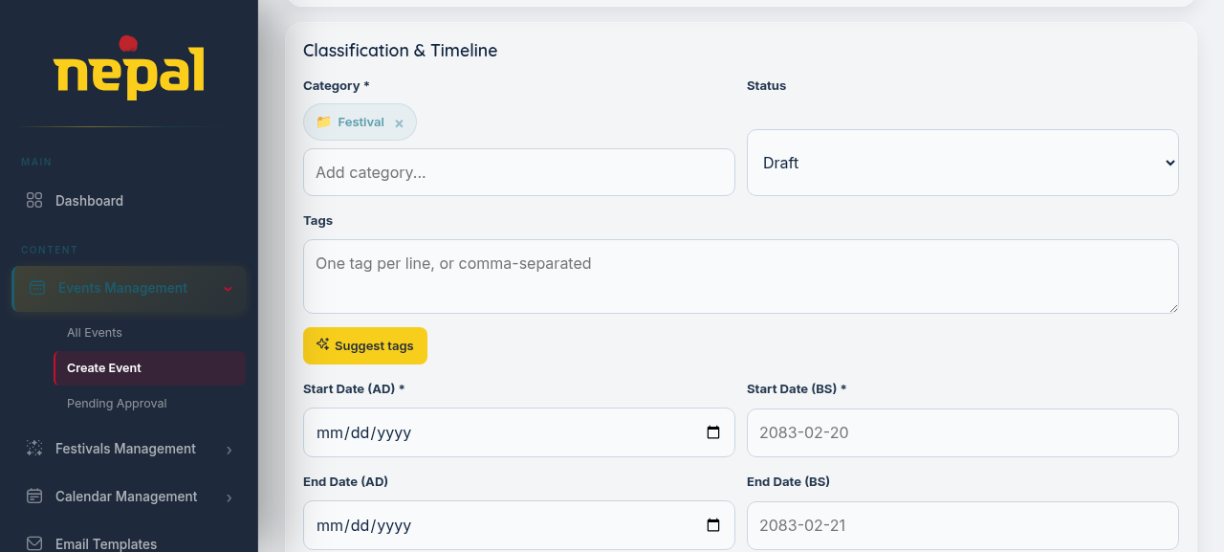
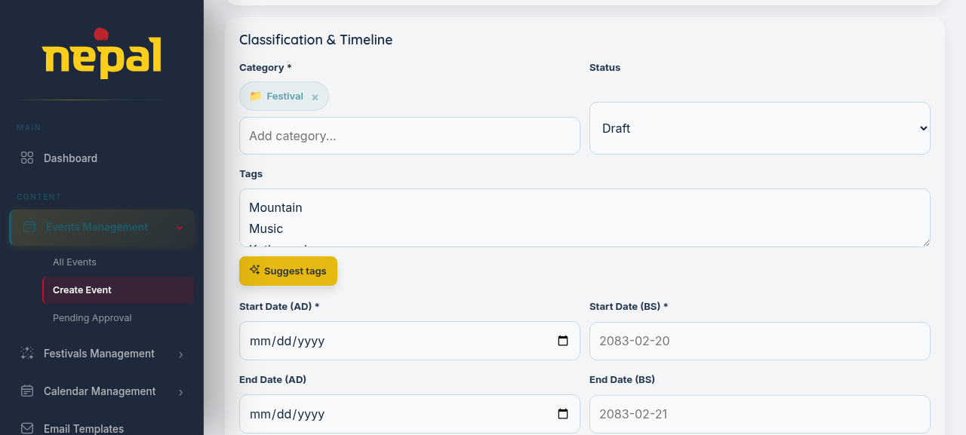
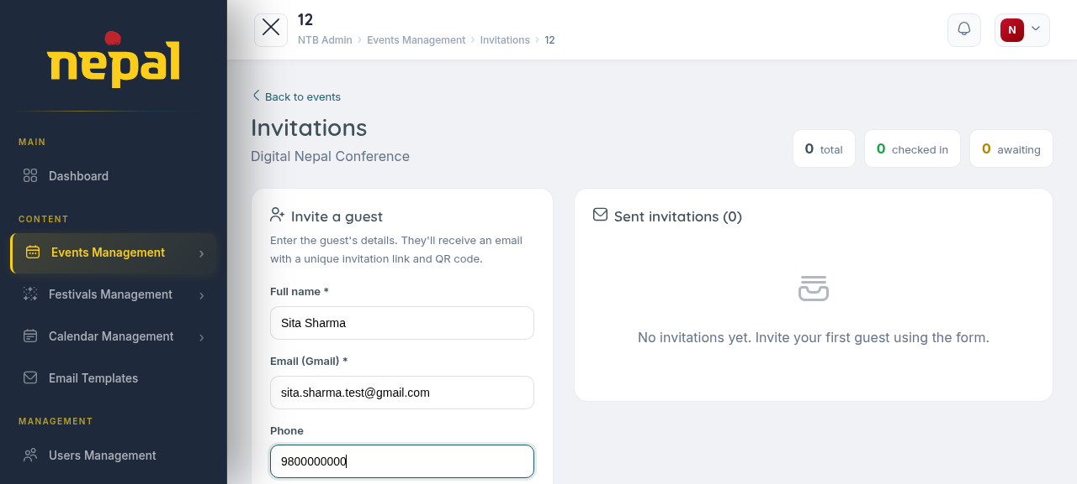
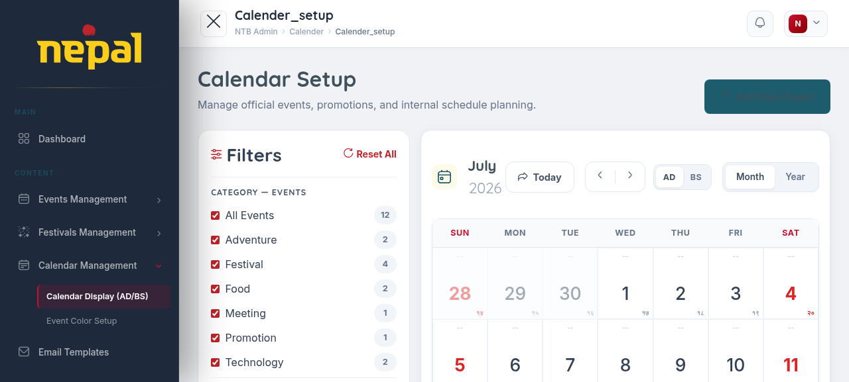
LIVE SYSTEM
Admin Panel — Working Screenshots
Admin Dashboard
Events Management List
Create Event Form (Category, Status, Tags)
AI Tag Suggestion in Action
Guest Invitation Form (Check-in Stats)
Admin Calendar Setup (AD / BS, Filters)
NTB Event Management System • Final Defense • 2026
18 / 23

Slide 19
TESTING
Testing Strategy & Results
xUnit + Moq — unit tests plus cross-service system tests against in-memory fakes
24 / 24
16
8
< 1 sec
Tests Passing
Unit Test Cases
System Test Cases
Full Suite Runtime
ID
Module
Test
Result
UT-07
AI – TF-IDF
ComputeTfIdf_SingleDocument_TermsWeightedByFrequency
✓ Pass
UT-10
AI – BM25
Rank_QueryTermInOneDocumentOnly_RanksThatDocumentFirst
✓ Pass
UT-12
AI – Tag Suggestion
SuggestTagsAsync_TitleWithFestivalKeyword_ReturnsRelevantExistingTag
✓ Pass
ST-02
System
Public user searches “Dashain festival” using smart search
✓ Pass
ST-06
System
Unauthenticated request to admin-only endpoint is rejected
✓ Pass
$ dotnet test NtbEvent.Tests → Passed! – Failed: 0, Passed: 24, Skipped: 0, Total: 24
NTB Event Management System • Final Defense • 2026
19 / 23

Slide 20
RESULTS
Result Analysis
By final defense, every component below is implemented, integrated and verified
✓
Full backend infrastructure — Clean Architecture, PostgreSQL + EF Core migrations, EF Core/Dapper hybrid
✓
Interactive calendar — month/list toggle, color coding, AD/BS toggle
✓
JWT login, refresh-token rotation, RBAC (SuperAdmin, Admin, Client)
✓
Event filtering by type, category, region and date range
✓
Complete Event CRUD — dual dates, image upload, tags, highlights, lifecycle status
✓
Guest invitation & QR check-in — invite → email+QR → scan → verify → consume
✓
Category & tag management with many-to-many associations and audit tracking
✓
All 4 AI modules wired to the frontend and verified against live seeded data (12 events, 6 categories, 22 tags)
✓
Admin dashboard — listing, pagination, status management, category setup
✓
24-case automated test suite (xUnit + Moq) — all 24 tests pass
✓
Public homepage — featured events sorted by popularity score
NTB Event Management System • Final Defense • 2026
20 / 23

Slide 21
CONCLUSION
Conclusion
A significant step forward in how Nepal's tourism events are managed, published and discovered
This final phase delivers a fully functional event platform — the complete lifecycle from admin event creation to public discovery, plus a digital guest invitation and QR check-in workflow. The system is feature-complete and deployment-ready.
4/4 AI Modules
Clean Architecture
Dual Calendar
24 / 24 Tests
Self-built in C# — no third-party AI API
Maintainable, testable, decoupled layers
AD & BS — real-world Nepali government need
Automated suite passes in full
NTB Event Management System • Final Defense • 2026
21 / 23

Slide 22
FUTURE WORK
Future Recommendations
1
Collaborative Filtering
2
Caching Layer
3
Event Ticketing
Extend recommendations with user behaviour data once interaction volume grows
IMemoryCache for pre-computed TF-IDF vectors & BM25 indices
Registration & payment for paid events directly on the platform
4
Native Mobile App
5
Analytics Dashboard
6
Reviews & Notifications
Cross-platform app reusing the existing API layer
Views, search queries, popular categories, regional engagement
User ratings/reviews plus subscription-based event alerts
NTB Event Management System • Final Defense • 2026
22 / 23

Slide 23
Thank You
Questions & Discussion Welcome
NTB Event Management System
Anjal Joshi • anjaljoshi6@gmail.com
Department of Computer Application • Tribhuvan University
NTB Event Management System • Final Defense • 2026
23 / 23

